Slide 1
Machine Learning Framework for Personalized Adaptive Learning: Enhancing Engagement through Dynamic Learning Style Adaptation
PORIPIREDDIKARTHIK-[BL.EN.U4CSE23142]
PORIPIREDDIKARTHIK-[BL.EN.U4CSE23142]
Presented By:
Ch.Suryavardhan [BL.EN.U4CSE23007]
P.V.S.R.S.Himakar [BL.EN.U4CSE23039]
T.Harika Bhargavi[BL.EN.U4CSE23055]

Slide 2
INDEX
Dataset Description
Preprocessing Steps
Models Used in Document Quality Assessment
Models description
Performance
Conclusion
Limitations

Slide 3
Dataset Description
POI and geometry: OpenStreetMap, Wikidata.
Content & images: Wikimedia Commons, Wikipedia summaries, local heritage archives (Europeana for EU, etc.).
User interaction logs: your app’s analytics DB (Postgres).

Slide 4
Pre-Processing Steps
I. POI Content Data Pre-processing (Static Data)
Load and Standardize POI Data: Load all Points of Interest (POI) attributes and content variants, ensuring geographic coordinates and text are in a consistent, standardized format.
Feature Engineering for POI Attributes: Calculate numerical feature vectors for each content variant (text length, audio duration, image count) and encode categorical attributes (POI category) for use in the recommendation models.

Slide 5
Pre-Processing Steps
II. User Interaction Log Pre-processing (Dynamic Data)
Load Logs: Ingest raw interaction logs (clicks, time, events).
Clean Logs: Remove corrupted entries (missing ID/timestamp).
Aggregate Features: Calculate metrics per user/POI (e.g., Time-on-POI, Audio Ratio).
Generate Reward Label: Define binary engagement R=1/0 using consumption thresholds.
Scale Features: Normalize continuous features (e.g., Min-Max or Standardization).
Sessionize: Group interactions into distinct user sessions.

Slide 6
Models Used
User Profiling & Learning-style Inference
K-means Clustering: Unsupervised grouping of users based on interaction features to discover common learning styles.
Logistic Regression / Random Forest: Lightweight classifiers to map new users' features to the established learning style labels.
Content Recommendation / Sequencing
Epsilon-greedy: Simplest bandit approach for the MVP to demonstrate real-time adaptation.
Engagement Prediction
XGBoost / Small Neural Net: Binary classifiers trained on historical logs to predict the probability of a positive user interaction (e.g., listening, completing a story).

Slide 7
Model 1 – Adaptive Content Sequencer (Contextual Bandit)
Model: Contextual Multi-Armed Bandit(e.g., LinUCB or Epsilon-Greedy for MVP).
Task: Personalized content selection — model chooses the optimal next content variant (arm) for a POI based on user context.
Input Context:
User Features (Profile): Inferred Learning Style, Time of Day, Recent Engagement Score.
POI Features (Arm): Content Type (Audio/Text/Image -> Arm ID), Length/Duration, Category.
Output: Selected Content Variant (Arm ID)with the highest expected reward.
Reward Signal (Rt): Binary (1 or 0) -> 1 if user engagement threshold is met (e.g., listens > 20s, scrolls > 80%).
Update Mechanism: Model updates arm's value/confidence after receiving the reward signal Rt for the chosen variant.
Initial Policy (MVP):
Algorithm: Epsilon-Greedy(simplest online learning).
Exploration Rate (e): 0.1 (10% random choice for exploration).
Initial Value: Uniformly high or optimistic to encourage initial exploration.

Slide 8
Model 2: Learning Style Classifier (User Profiling)
Model: Lightweight Classifier (e.g., Logistic Regression or Random Forest).
Task: Infer the user’s preferred learning style/profile (e.g., Auditory, Visual, Textual) from interaction patterns.
Input Features: Aggregated Interaction Metrics (Time-on-POI, Audio Ratio, Scroll Depth, Images Viewed Count).
Output: User Profile Label (e.g., Profile A: Visual Learner).
Training Dataset: Logs labeled with profiles derived from initial K-means Clustering (unsupervised labeling).
Inference Method: TensorFlow.js (TF.js) for fast, client-side, real-time prediction upon new interaction data.

Slide 9
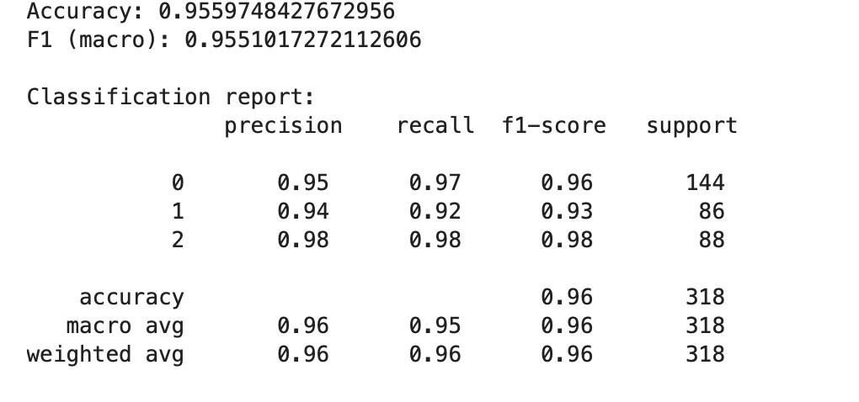
Perfomance

Slide 10
Conclusion
Built an adaptive learning framework to personalize cultural heritage tours using real-time user interaction data.
Successfully implemented a Contextual Bandit model to dynamically sequence content (audio/text/image) based on user context and engagement.
Demonstrated real-time adaptation using a lightweight online learning approach suitable for a web application MVP.
Next steps:
Integrate the trained User Profile Classifier (TF.js) for robust profile inference.
Perform an A/B test to measure the lift in engagement rate compared to a non-adaptive baseline.
Expand the POI catalog and refine the reward function for longer-term engagement optimization (via reinforcement learning).

Slide 11
Limitation
Limited POI/Content Data: The MVP relies on a small, manually curated set of POIs and content variants; this limits the diversity and scope of the cultural tour experience.
Simple Reward Function: The initial bandit reward (R=1/0) is simplistic (based only on time/scroll thresholds) and may not fully capture nuanced user satisfaction or true learning value.
Cold-Start Problem: The system starts with little or no information for new users and new POIs, leading to a period of initial random or default content sequencing until sufficient data is collected.
No Continuous Learning: Model retraining (K-means, Classifier) is an offline, nightly task; the underlying user profile doesn't adapt in real-time within a single, prolonged user session.
Location Granularity: Geolocation accuracy can vary, potentially triggering POI content too early or too late, which could disrupt the user's flow and context.

Slide 12
THANK YOU

